Slide 1
CG2271 Real Time Operating Systems
Lab Lecture 5
PWM Programming
(Reference Guide Chapter 29)

Slide 2
Introduction
Lab Lecture 5 – PWM Programming

Slide 3
Introduction
The three Timer/PWM Modules (TPMs) produce a total of 10 PWM outputs (See next slide)
  PWM signals can either be edge-aligned or centre aligned.
  Equivalent to the ATMega328P’s fast PWM and phase-correct PWM respectively.
Most of what we need to know about the TPMs was already covered in Lab Lecture 4.
  Please view that lecture first if you’ve not already done so.

Slide 4
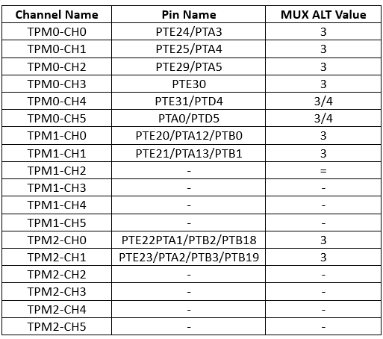
PWM Pin Outputs

Slide 5
Setting up the pwm
Lab Lecture 5 – PWM Programming

Slide 6
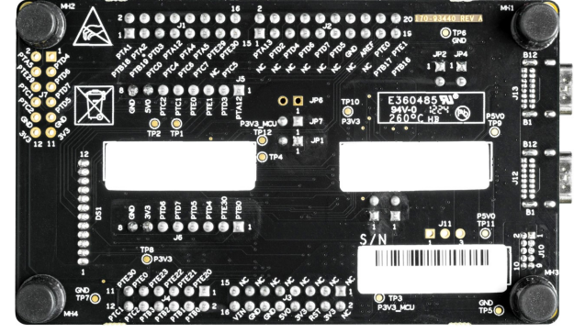
Basic TPM Setup
We will now look at how to drive PTE21.
  This is available on the FRDM-MCXC444 board header.
    Corresponds to TPM1_CH1

Slide 7
Basic TPM Setup
Steps from Lab Lecture 4:
  1. Set up Multipurpose Clock Generator (MCG) to produce an 8 MHz clock rate.
  2. Set up the TPM clock source in SIM_SOPT2.
  3. Clear the PS bits.
  4. Set the PS bits to 0x7 (128) and the TOIE bit if necessary.
  5. Clear TPMx_CNT.
  6. Set TPMx_MOD to determine PWM frequency. (see next page)

Slide 8
PWM Frequency
To simplify matters we will set a prescalar of 128.
We use the TPMx_MOD modulo to set the PWM frequency:
  Too low: LED flickers, increased motor noise, etc.
  Too high: Increased power consumption due to switching losses.
We will not worry too much about switching losses, so we choose a PWM frequency of 250 Hz.
  This will give us very nice smooth operations.

Slide 9
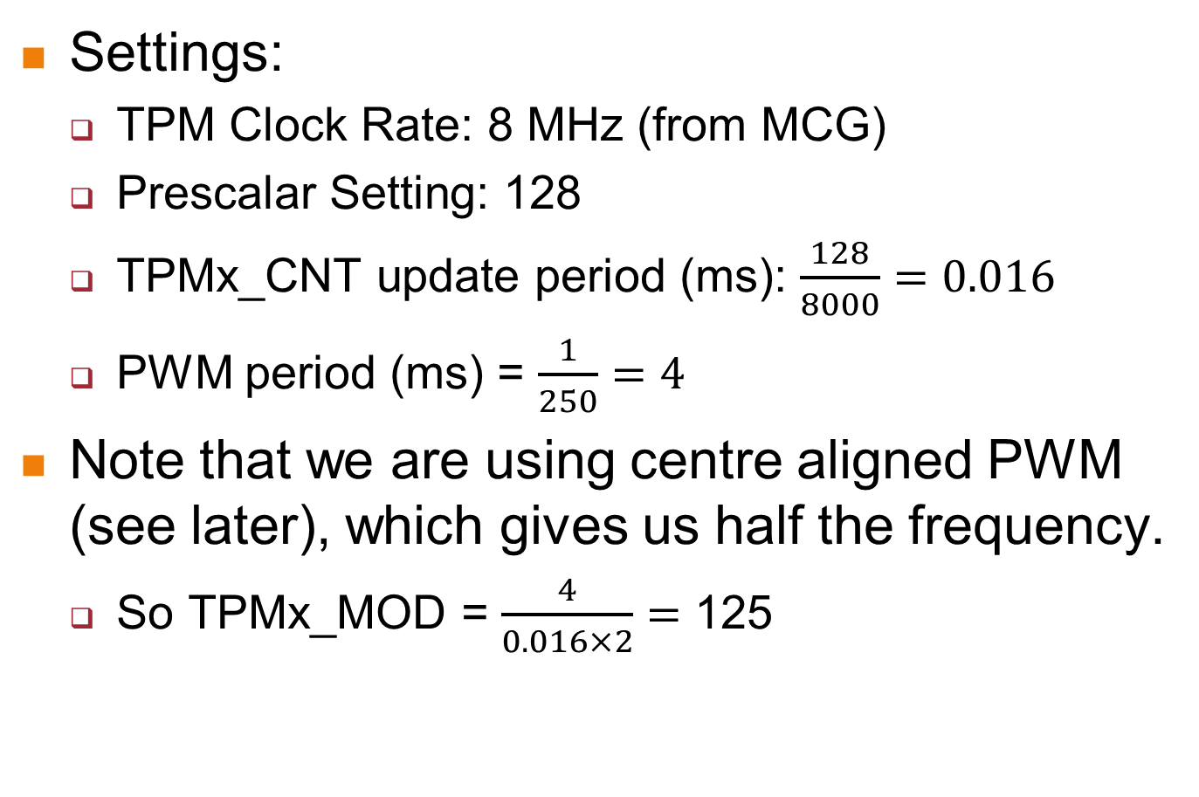
PWM Frequency
Settings:
  TPM Clock Rate: 8 MHz (from MCG)
  Prescalar Setting: 128
  TPMx_CNT update period (ms): $\frac{128}{8000}=0.016$
  PWM period (ms) = $\frac{1}{250}=4$
Note that we are using centre aligned PWM (see later), which gives us half the frequency.
  So TPMx_MOD = $\frac{4}{0.016×2}=$ 125

Slide 10
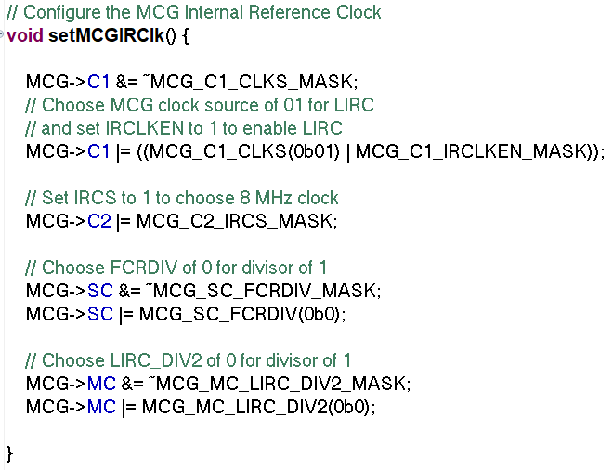
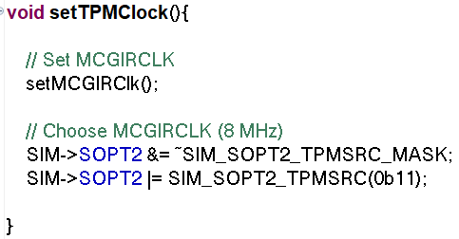
Full Basic Setup Code
Set up MCG and TPM Clock Source

Slide 11
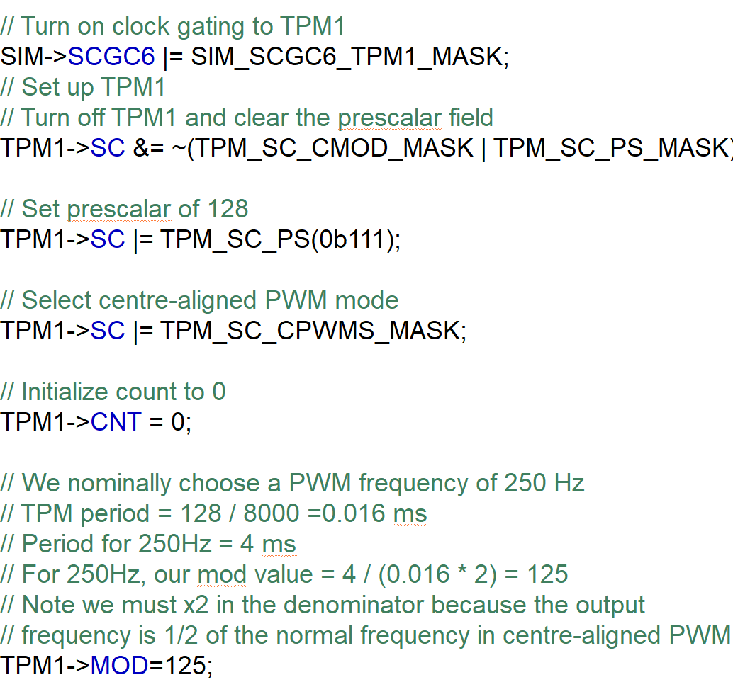
Full Basic Setup Code
Set up TPM1 (since PTE21 is connected to it)

Slide 12
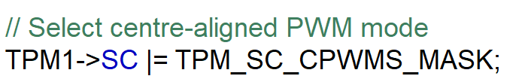
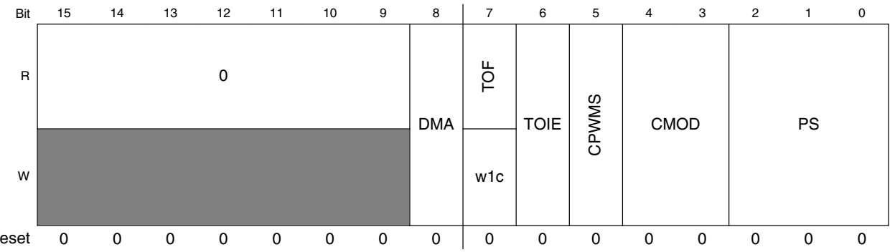
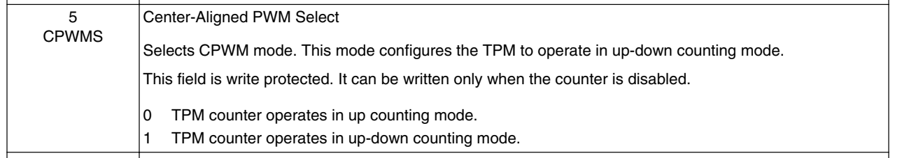
Full Basic Setup Code
Notice there is one extra line in the setup code:
This sets up the CPWMS bit in the TPM status and control register to choose between edge-aligned and centre-aligned PWM.

Slide 13
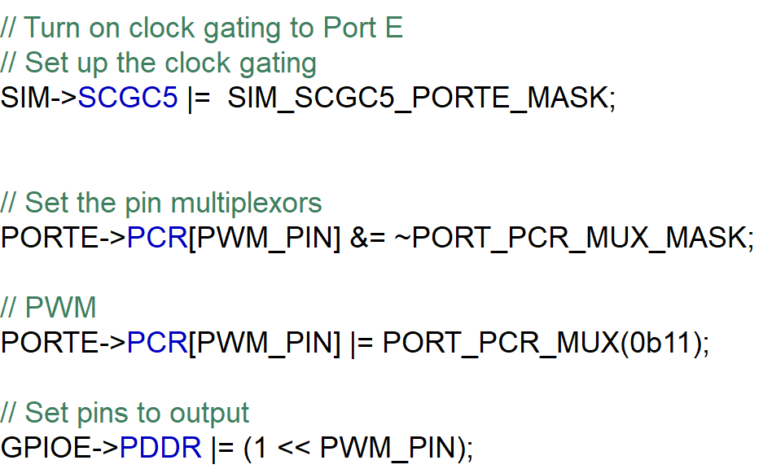
Setting Up the PWM Outputs
We can now set up the PWM on PTE21, which is ALT3.
Not strictly necessary to set the respective pins as output, but we do so for clarity:

Slide 14
Setting Up the PWM Outputs
Finally we configure the PWM channel”
  Table below shows the channel number for PTE21:

Slide 15
Setting Up the PWM Outputs
From the table we see we need to set up TPM1 Channel 1.
  We configure through the channel status and control register1 TPM1_C1SC
  Programmatically this is accessible via:
    TPM1->CONTROLS[1].CnSC
  PWM Duty Cycle is set using the TPM1_C1V, Corresponds to TPM1->CONTROL[1].CnV

Slide 16
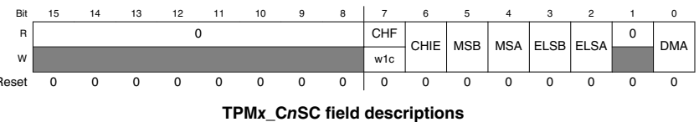
Setting Up the PWM Outputs
We set the CPWMS bit in TPM1_SC to 1, using centre-aligned PWM.
We can refer to the Section 29.4.4 to see how to configure the PWM output in the TPMx_CnSC register:
  MSnB:MSnA bits set the pin mode.
  ELSnB:ELSnA bits set the pin polarity.

Slide 17
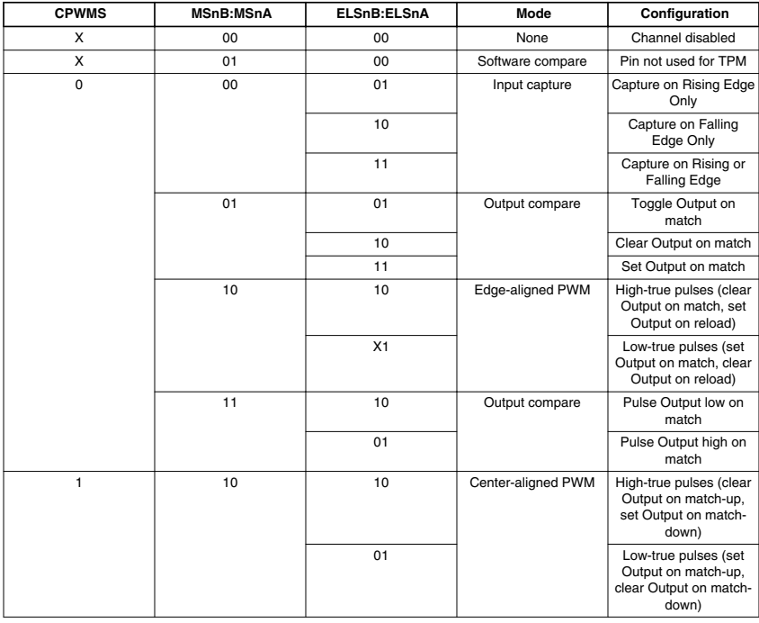
Setting Up the PWM Outputs
With CPWMS=1, MSnB:MSnA = 0b10 sets centre PWM output.
Setting ELSnB:ELSnA controls the polarity of the PWM signal.

Slide 18
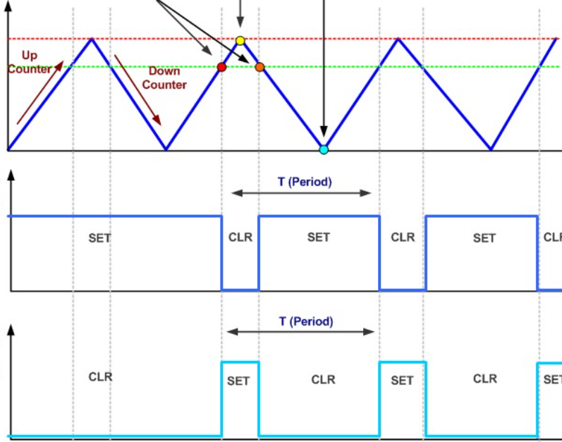
Choosing PWM Polarity
ELSnB:ELSnA = 0b10
  High True: Clear pin matching CnV counting up, set pin matching CnV counting down.
ELSnB: ELSnA = 0b01
  Low True: Set pin matching CnV counting up, clear pin matching CnV counting down.
ELSnB:ELSnA = 0b10
ELSnB:ELSnA = 0b01

Slide 19
Choosing PWM Polarity
We are going to generate a conventional PWM signal (High-True Pulse), so:
  We clear MSB:MSA and ELSB:ELSA as usual using inversions of the masks.
  We set MSB=1 to give MS=10, and ELSB to 1 to give ELS=10.

Slide 20
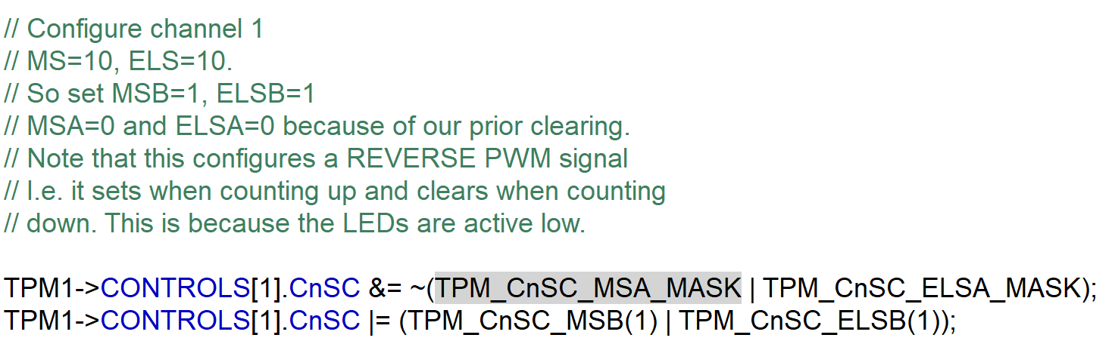
Choosing PWM Polarity

Slide 21
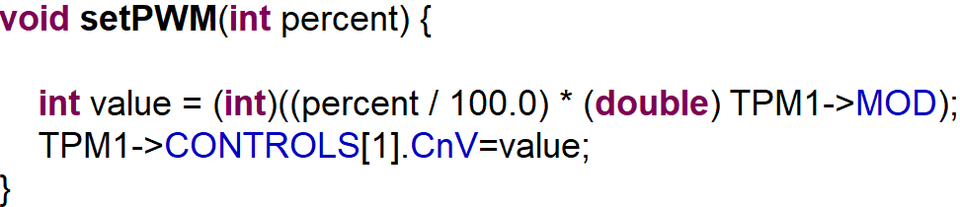
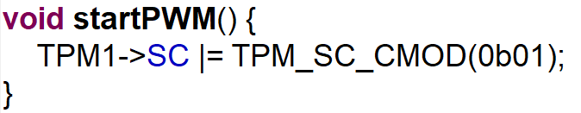
Set the PWM Value and Turning On
We set the PWM value for a channel n by writing to TPM1->CONTROL[1]->CnV
As before with the timer, we turn on the PWM signal by writing a 1 to the CMOD bit in TPM0_SC:

Slide 22
Conclusion
In Lab Lecture 4 we looked at the TPM module and learnt how to set up a timer.
In this lecture we extended the idea to generate PWM signals.
In the next lecture we will look at how to use the Analog-Digital Converter (ADC) on the MCXC444.

